Slide 1
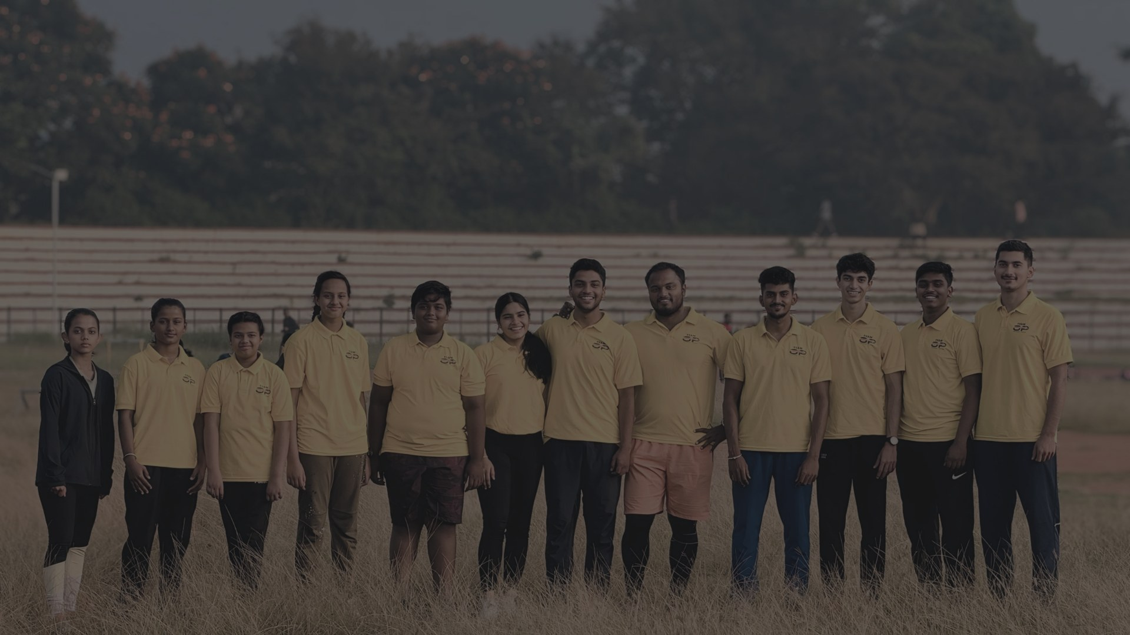
COACHING PROFILE
A SPRINTER'S STANDARDS.
A TEACHER'S PURPOSE.
A COACH'S PATIENCE.
RADESH M.G
Physical Educator | Athletics Coach
ACE-Certified Coach | Strength & Conditioning
MYSURU, KARNATAKA

Slide 2
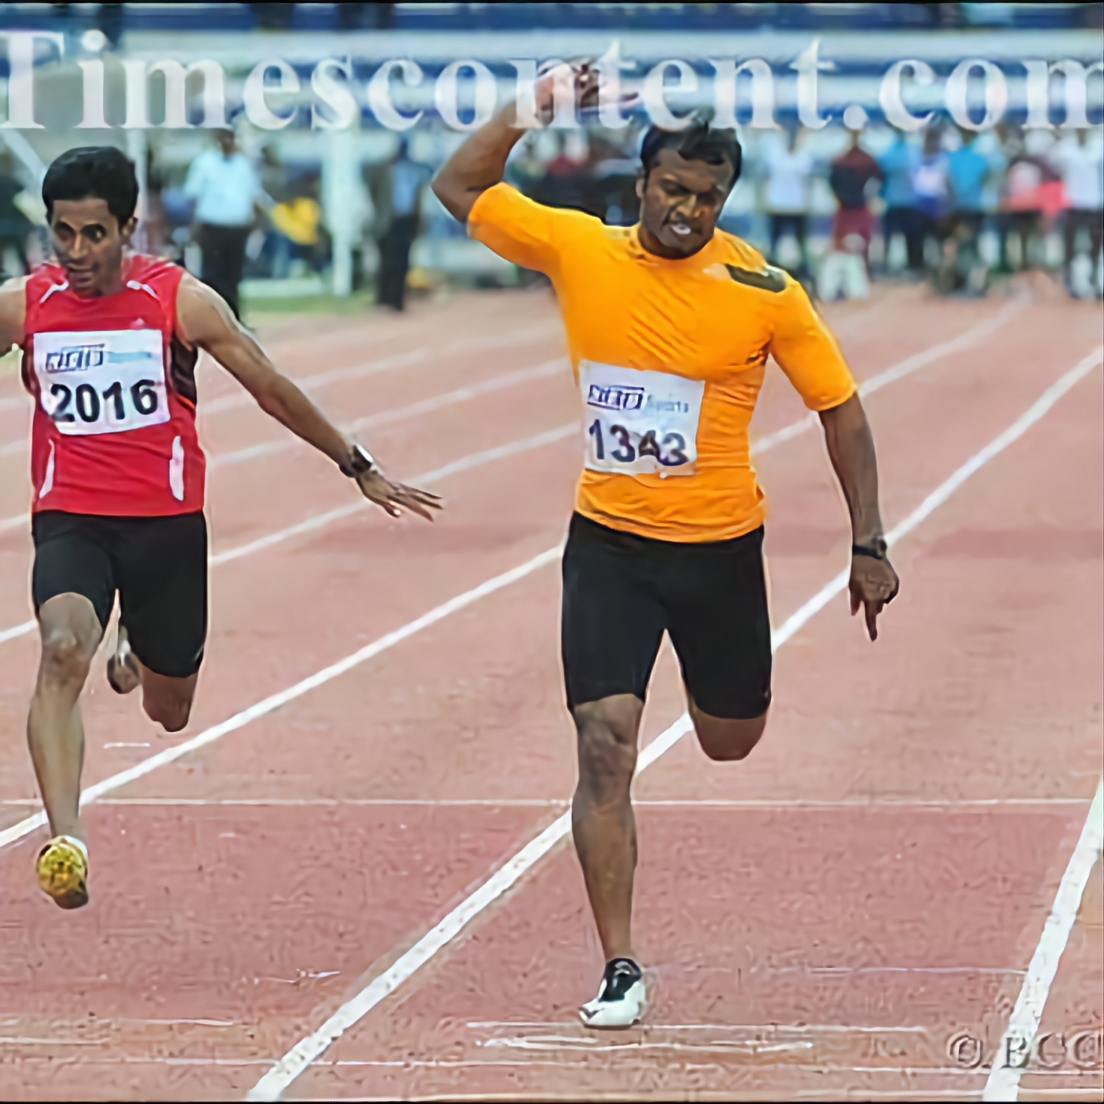
THE ATHLETE BEFORE THE COACH
Athletics gave the dream a clock.
The journey began on a school ground — first Kho Kho, then basketball, and finally athletics.
KHO KHO
BASKETBALL
ATHLETICS
10.21
20+
100m personal best
National-level competitions representing Karnataka
The dream: wear the India jersey. The standards built in pursuit of it still shape every session today.
02

Slide 3
COMPETITIVE STANDARDS
The clock taught standards that still shape every session.
10.5
10.7
10.5
10.69
10.32
State Junior & Senior gold · 2016
National Inter-State Senior · Hyderabad 2016
Karnataka State Olympic gold · 2017
Federation Cup National Senior · 2017
Finished 1st · National Inter-State trials
OFFICIAL AFI • 56TH NATIONAL OPEN • 2016
100m heat winner — 10.87s | Semi-final — 10.77s
Best Athlete 2016–17 • Nandi Award
03

Slide 4
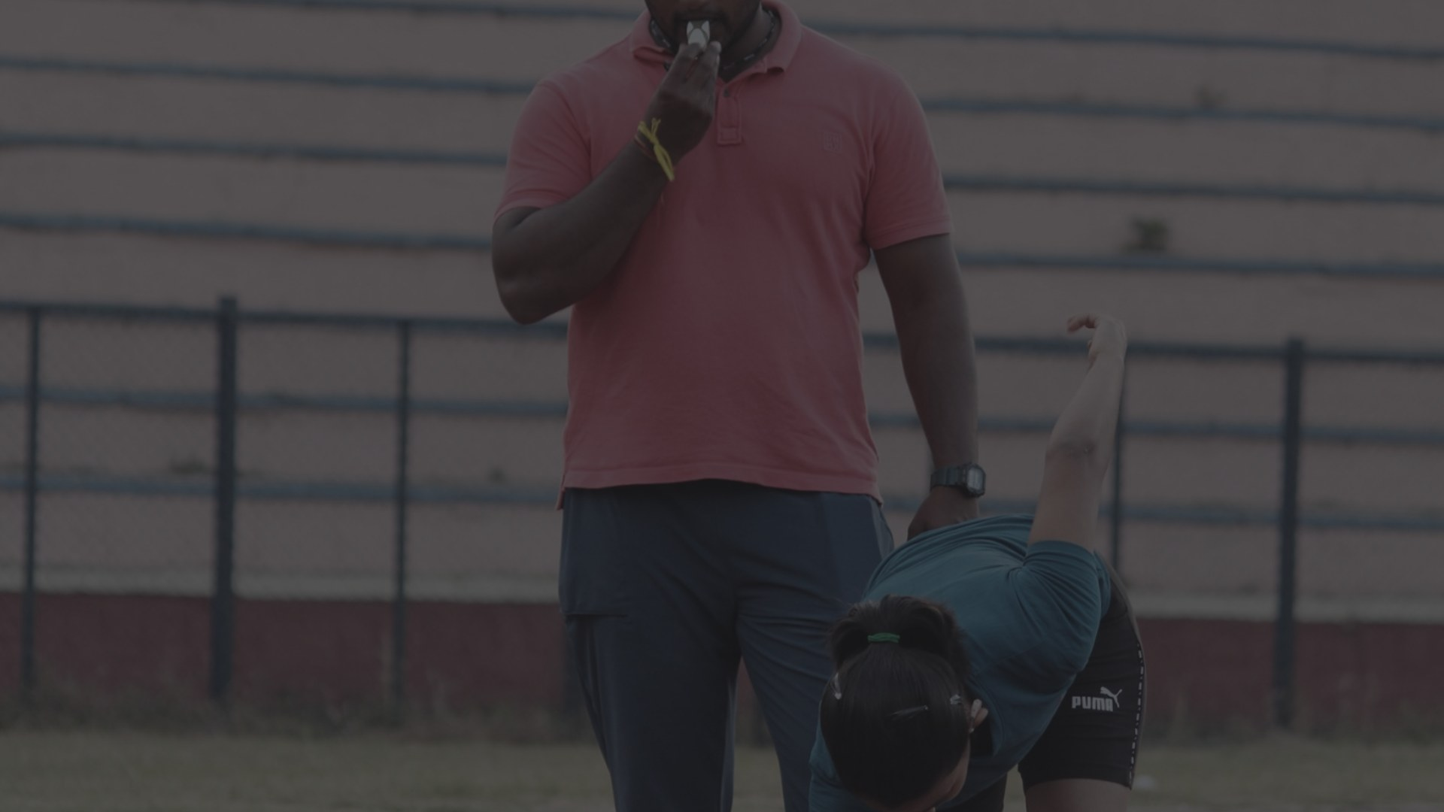
THE TURNING POINT
Injury changed the finish line —
and revealed the purpose.
A serious spinal injury ended the pursuit of the India jersey. Recovery became an education in movement, injury prevention, strength and conditioning.
Not only 'How do we perform?' — but 'How do we progress safely, rebuild confidence and protect the next opportunity?'
Working alongside physiotherapists in an exercise-support role changed the coaching question.
04

Slide 5
PROFESSIONAL JOURNEY
Responsibility grew across school, performance and academy roles.
2014–2018
FOUNDATIONS
Early-years and school-sport teaching across multiple learning environments.
2016–2022
PERFORMANCE + EXERCISE SUPPORT
Fitness, performance, physiotherapy-centre exercise support and school-sport roles.
2021–PRESENT
ST. LAWRENCE INTERNATIONAL SCHOOL, MYSORE — CURRENT
Physical Educator at St. Lawrence International School.
2016–PRESENT
TEAM OPTIMUM POWER — FOUNDER / HEAD COACH
Academy leadership alongside school and session-based work.
CURRENT: ACE-CERTIFIED COACH • Functional Trainer • Group Class Specialist • IAAF youth track training • JumpBunch youth specialist
05

Slide 6
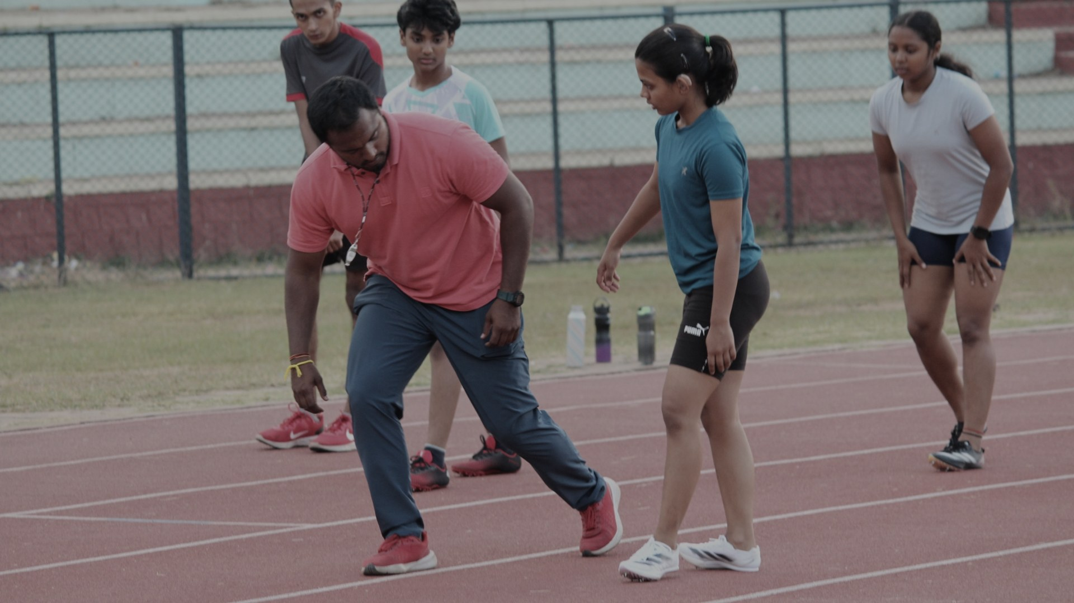
COACHING BELIEF
The standard is high.
The pathway stays human.
01
Every child deserves the opportunity to discover their physical potential.
02
Strong fundamentals and patient development create champions.
03
Discipline and consistency build confident performers.
Discipline means reliable structure — not punishment.

Slide 7
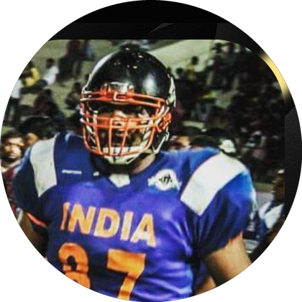
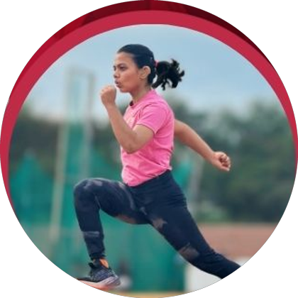
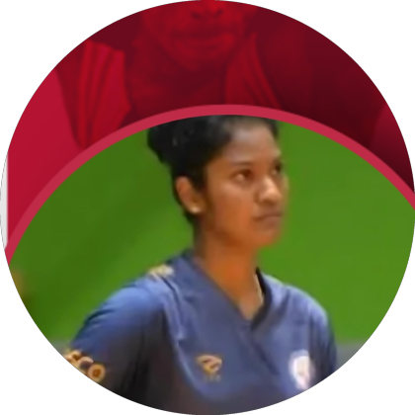
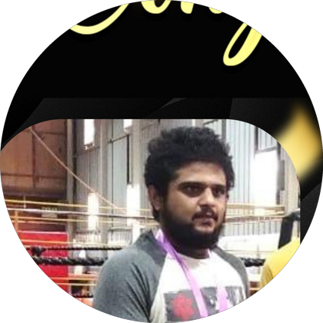
TESTIMONIALS
What athletes and families say.
"Six weeks with Radesh made me the strongest I had ever been — both physically and mentally."
"Coach Radesh never let my hearing impairment be a barrier. He adapted every drill — and I kept breaking my own records."
YASH SHETTY
RISHITA
India • National American Football team
Sprinter • National deaf 200m record holder
"He helped me come back stronger, faster and more confident than ever after my ACL injury."
"Training transformed my life — first fitness, then five years of competitive combat sport."
NITHYA KJ
MOHIT A S
Professional volleyball player
Combat sports athlete
07

Slide 8
SCHOOL-READY EXPERIENCE
School sport must serve every child —
and reveal the next step.
EVERY CHILD
EVERY ATHLETE
EVERY SCHOOL
— Age-specific K–12 PE
— Talent identification
— Consistent routines
— Inclusive participation
— Safe progression
— Teacher–parent communication
— Confident movement
— Competition readiness
— A visible sports culture
CURRENTLY: Physical Educator • St. Lawrence International School, Mysore • 2021–Present
08

Slide 9
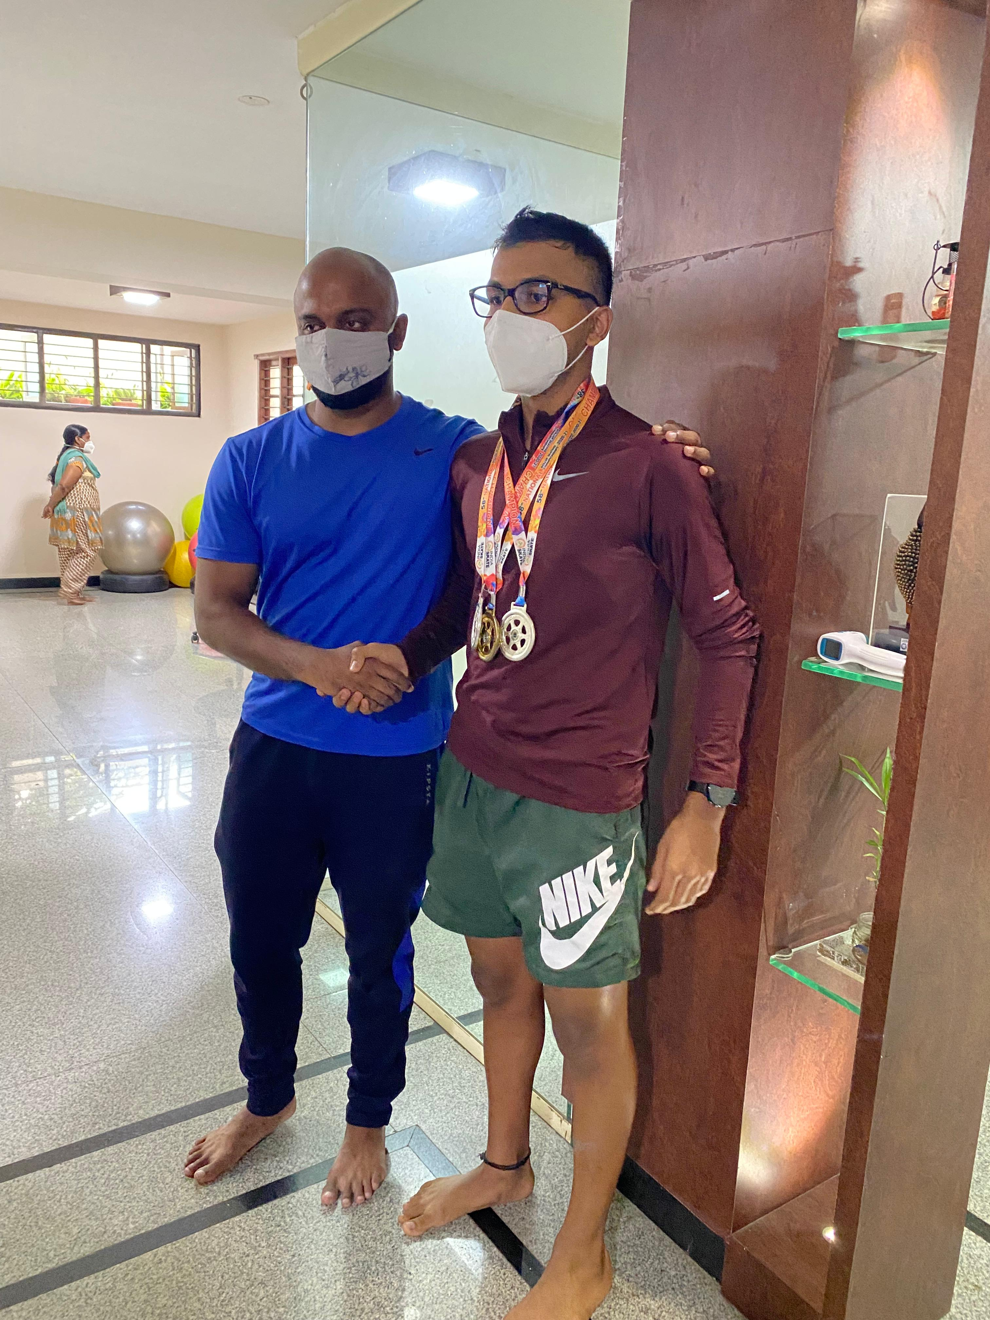
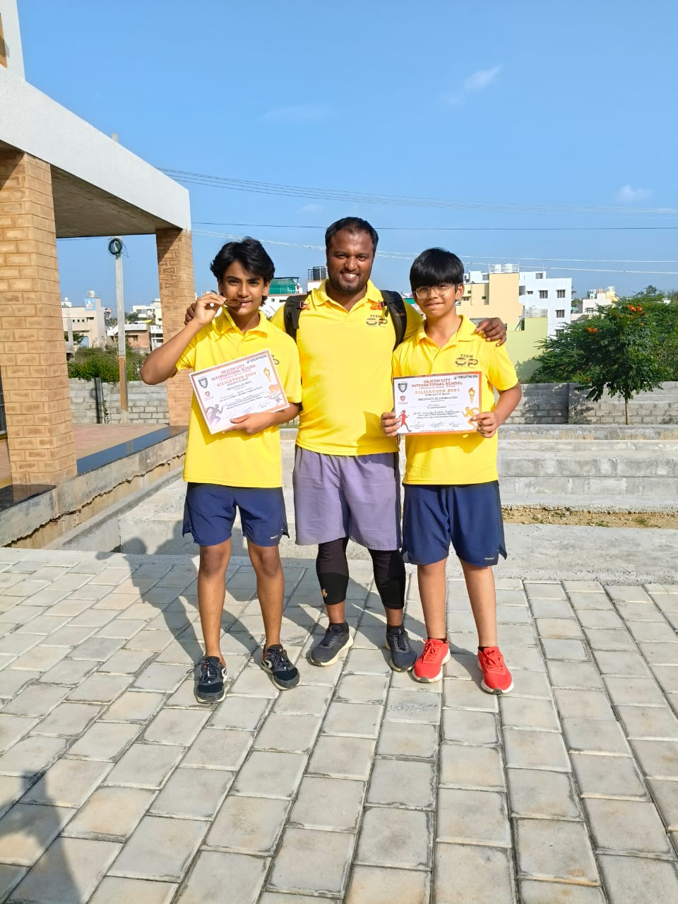
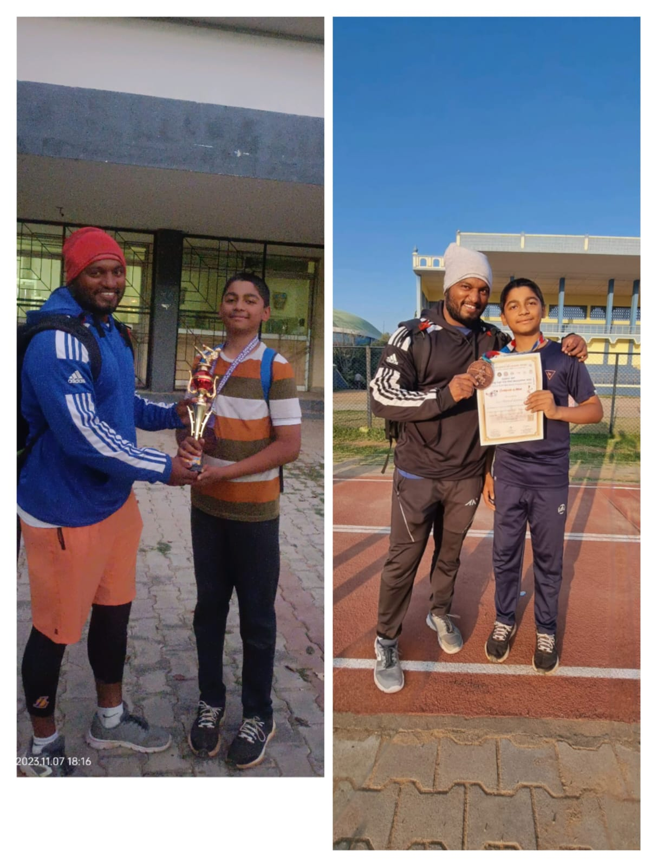
EVIDENCE ACROSS SPORT
Across sports, the method remains the same.
ANUSH
SCHOOL ATHLETICS
KARATE
National skating champion
Mysore district champions
National-level gold medallist
Balance • speed endurance • recovery
Fundamentals • confidence • readiness
Strength • mobility • power
The athlete owns the achievement. Coaching builds readiness.
09

Slide 10
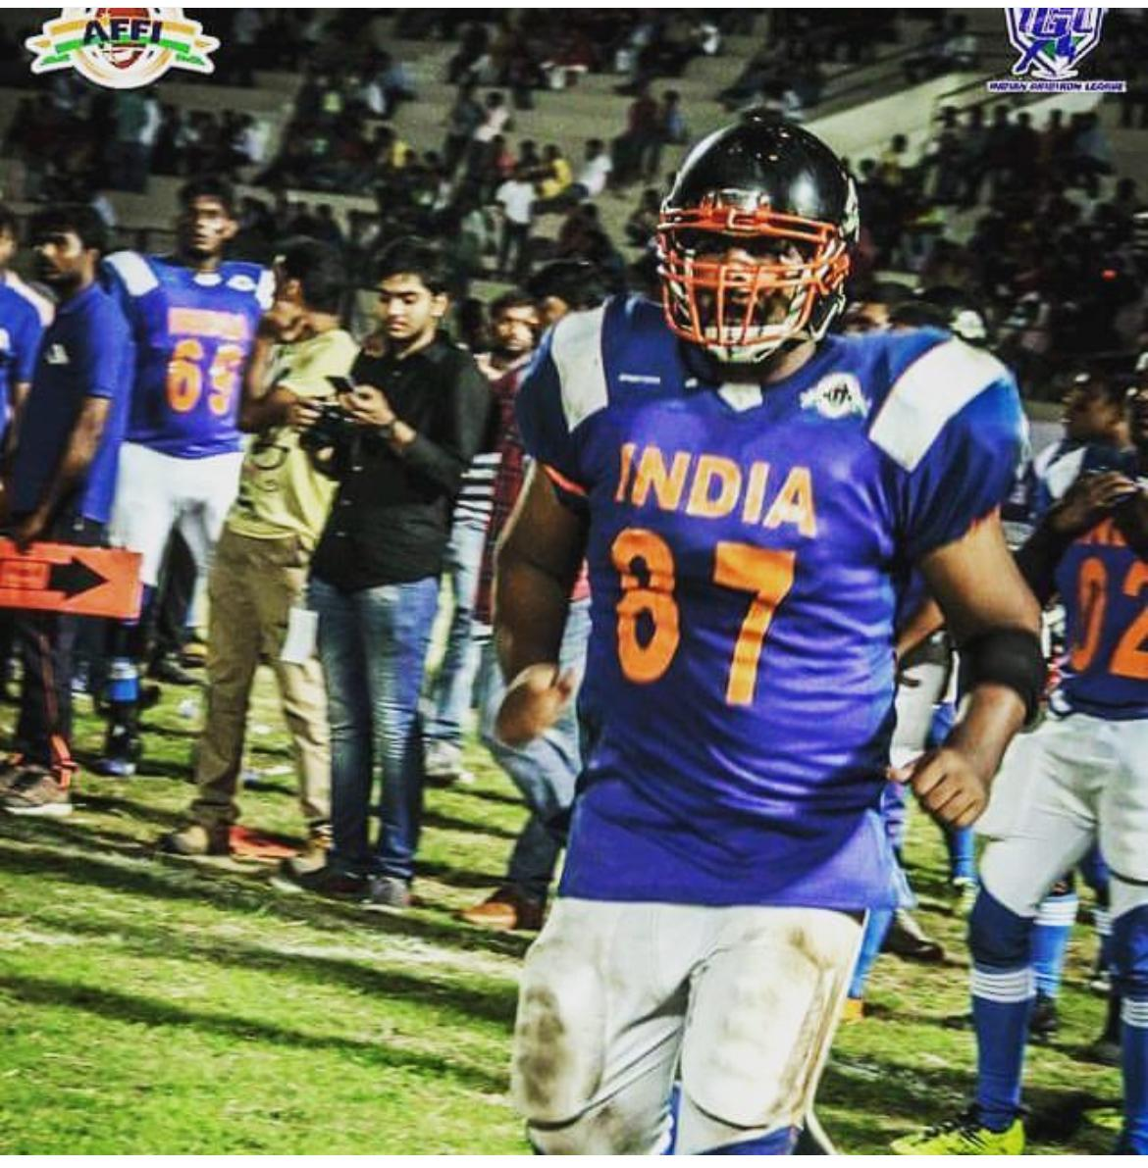
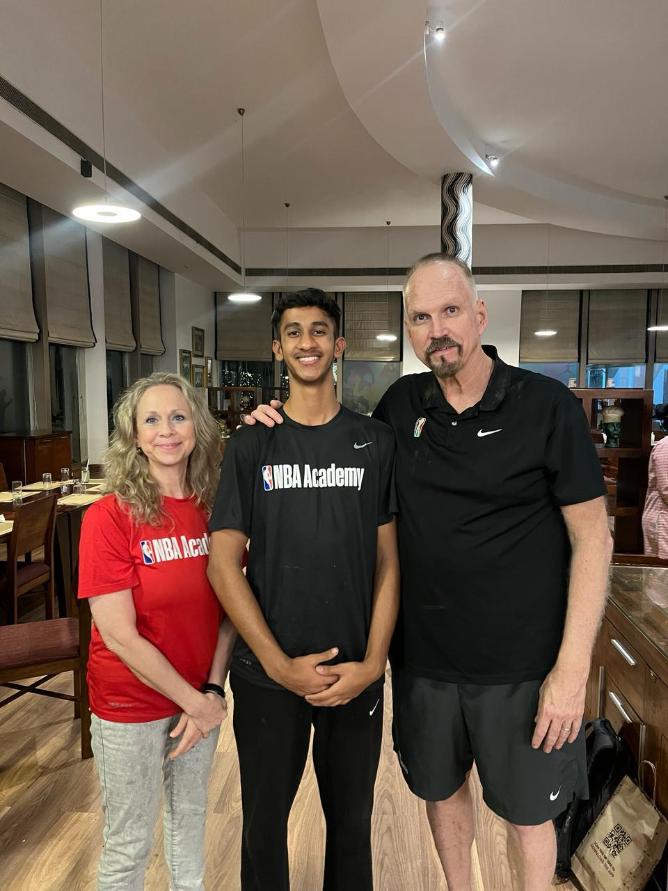
PERFORMANCE PATHWAYS
Preparation creates the next opportunity.
24.81
National deaf 200m record
RISHITHA
National 100m champion
Selected to represent India
2026 Asian Deaf Games
YASH SHETTY
KUSHAL
India at university level
NBA Academy India
Six weeks of focused preparation supported national-team selection readiness.
Basketball-specific strength, endurance and agility supported his development pathway.
Photograph intentionally withheld.
10

Slide 11
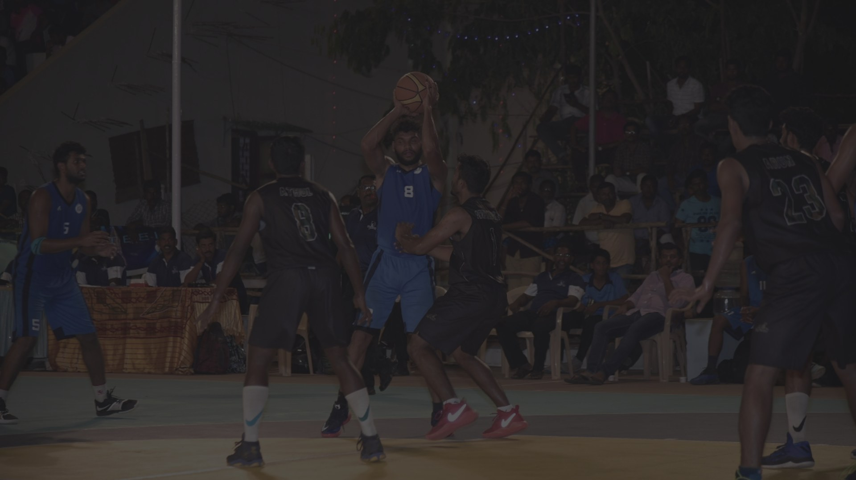
RETURN-TO-PLAY CONDITIONING
Return begins by rebuilding belief.
SHARATH M PRASAD
"Coach Radesh believed in my comeback when even I had doubts."
8 national basketball participations
After a major shin injury, Sharath rebuilt strength, agility and confidence — then returned to national-level competition, where his team won.
NITHYA KJ • PROFESSIONAL VOLLEYBALL
Following an ACL injury, injury-aware conditioning supported her return to court with renewed strength, mobility and confidence.
Return-to-play conditioning is coordinated with medical professionals.
11

Slide 12
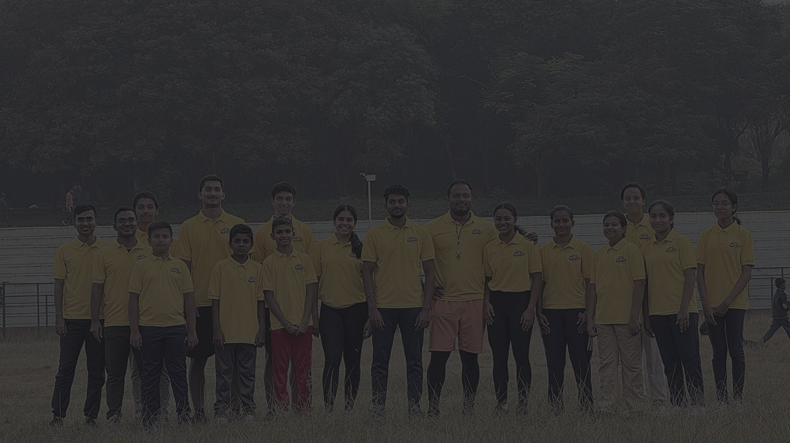
WHAT YOUR SCHOOL GAINS
The first 90 days begin with listening.
01
02
03
UNDERSTAND
ESTABLISH
ACTIVATE
Listen to leadership, teachers, students and the existing sports culture.
Create age-appropriate PE routines, observation methods and safe progression standards.
Strengthen participation, identify potential and connect athletes to the next opportunity.
TEACHER. COACH. ATHLETE MENTOR.
Let's discuss your school's vision. | Mysuru, Karnataka | +91 81053 39251

